Slide 1
CS214 Project
Project Title: Contact manager
Date: February 8, 2025
Instructor: Osama Al-Zakan
Team Members:
رحال مكي
أحمد علاء الدين قميلة
ثابت الملحم
حاتم الحسيني
بسام البليهي

Slide 2
Project Overview
This project implements a simple Contact Manager application in C++. Users can:
Add, Delete, Edit and search Contacts
View all saved contacts The system organizes contacts by the first letter of the name, using a hash table of linked lists.

Slide 3
Data Structures Used:
Array: for saving the pointers (head) for the linked list. Linked List: for saving the contacts with the common key(letter). Hash Table: Is the combination of the two pulse a function to determine the index (key) on the Array off the Linked list that the contact will be saved into

Slide 4
Hash Table Implementation
26 buckets (A-Z) based on first letter of name
Hashing function: getIndex(char c) converts first letter to array index
Collision handling through chaining (linked lists)

Slide 5
Contact Class
Attributes: name, phone, email
Getter and setter methods
Encapsulation through private data members

Slide 6
Contact Manager Class
Hash table implementation
Methods for manipulating , printing and Searching Contacts
Duplicate phone detection

Slide 7
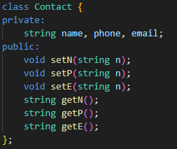
Contact Management System Explained
This part creates a simple class to store contact information:
It has three private variables: name, phone, and email
It has "setter" methods to set values in these variables
It has "getter" methods to retrieve these values
This design follows the encapsulation principle by keeping data private and providing controlled access

Slide 8
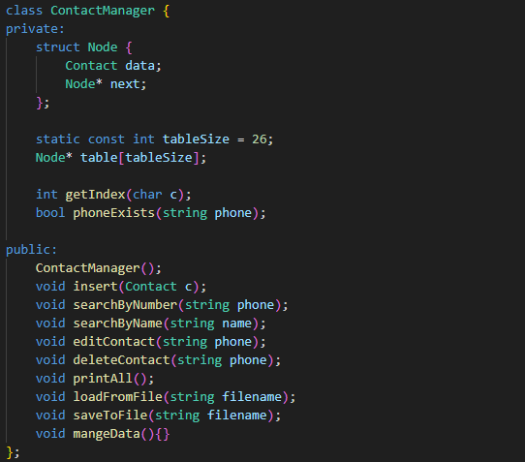
Contact Management System Explained (cont.)
It uses a hash table with linked lists (array of 26 pointers to Node structures)
struct Node defines each element in the linked lists, containing a contact and a pointer to the next node
tableSize = 26 represents the 26 letters of the alphabet (A-Z)
getIndex() converts a character to its corresponding index (0-25) in the table
phoneExists() checks if a phone number already exists in any list to prevent duplicates

Slide 9
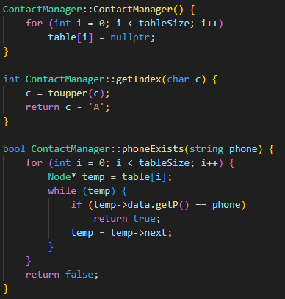
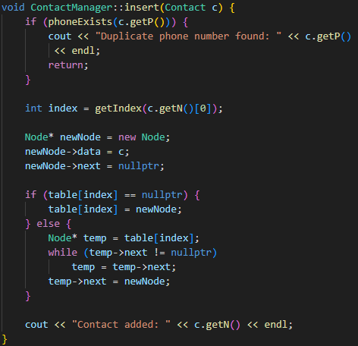
Contact Management System Explained (cont.)
A constructor that initializes all table entries to nullptr (empty)
The insert() method that adds a new contact:
First checks if the phone number already exists
Calculates which list to put the contact in based on the first letter of the name
Creates a new node for the contact
Either makes it the first node (if the list is empty) or adds it at the end of the existing list
Confirms the contact was added successfully

Slide 10
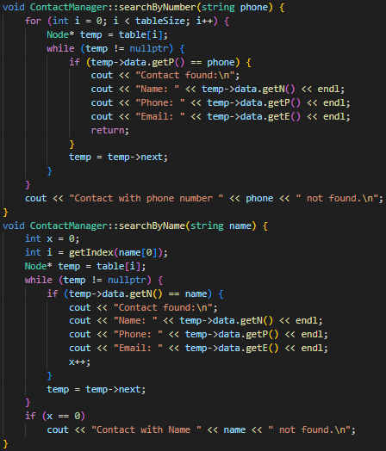
Contact Management System Explained (cont.)
These methods handle searching contacts:
The searchByNumber () finds a contact by phone number by checking every list
The searchByName() finds a contact by name, but only needs to check one list (more efficient)

Slide 11
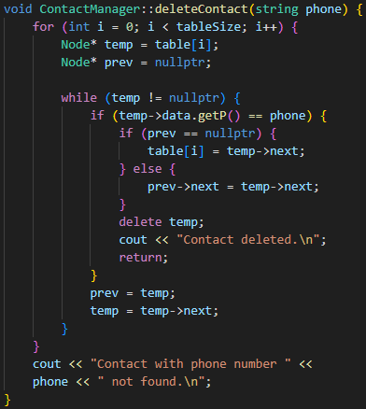
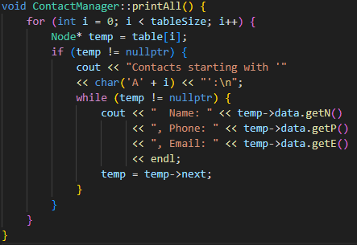
Contact Management System Explained (cont.)
The deleteContact() removes a contact by phone number and handles the linked list connections
The printAll() displays all contacts organized by the first letter of their names

Slide 12
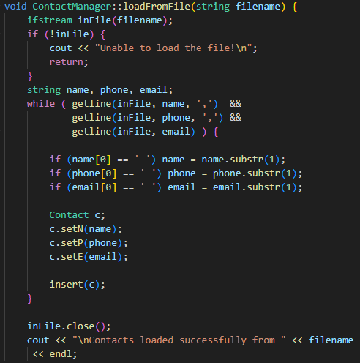
Contact Management System Explained (cont.)
The loadFromFile() reads contacts from a file (name,phone,email)
Creates a Contact object for each line and inserts it into the file

Slide 13
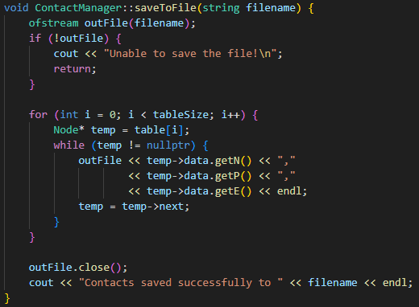
Contact Management System Explained (cont.)
The saveToFile() writes all contacts to a file
It goes through all lists and writes each contact's information

Slide 14
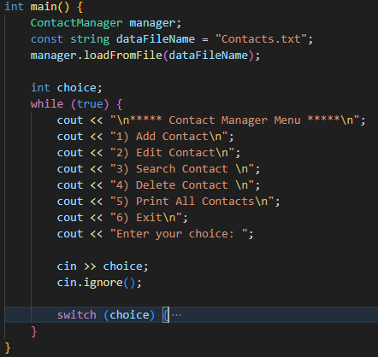
Contact Management System Explained (cont.)
The main function provides the user interface:
It creates a ContactManager object.
loads the Contacts from the file.
Displays a menu in a continuous loop until the user chooses to exit.
For each menu option, it collects necessary input and calls the appropriate ContactManager method.

Slide 15
Contact Management System Explained (cont.)
Option 1: allows adding multiple contacts at once.
Option 2: editing any aspect of a contact.
Option 3: allows searching for contacts either by a number or name.
Option 4 : is for deleting a contact.
Option 5: is for printing all contacts.
Option 6: for exiting and saving any changes from the program to the contact file.

Slide 16
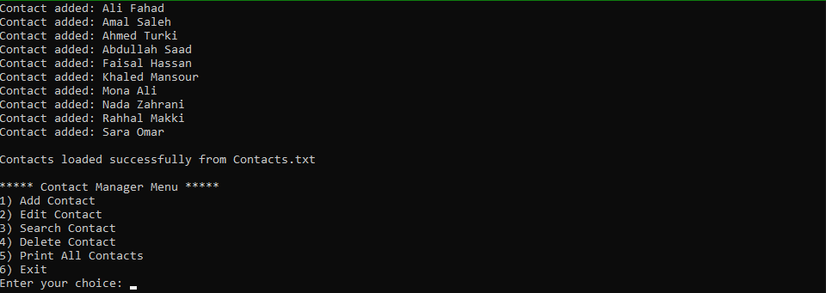
Output section
Program launch

Slide 17
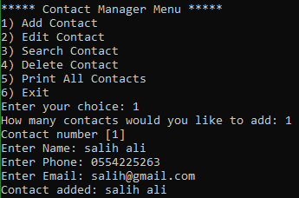
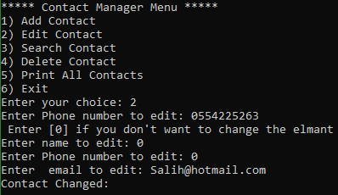
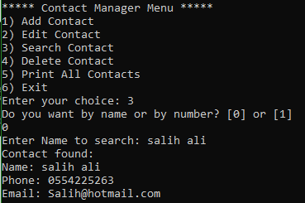
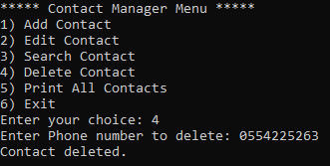
Adding
editing
Searching
Deleting

Slide 18
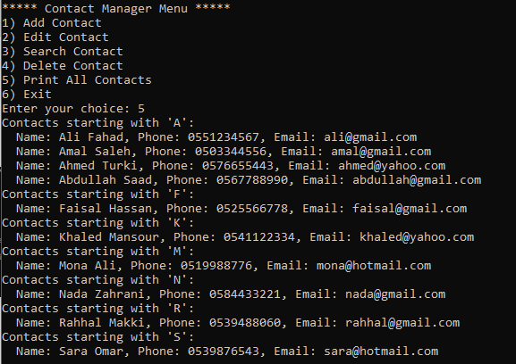
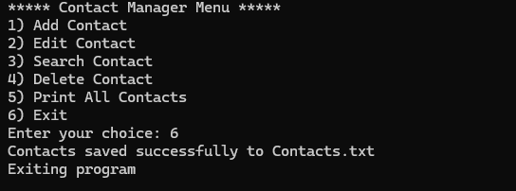
Printing all contacts
Exiting and saving all changes

Slide 19
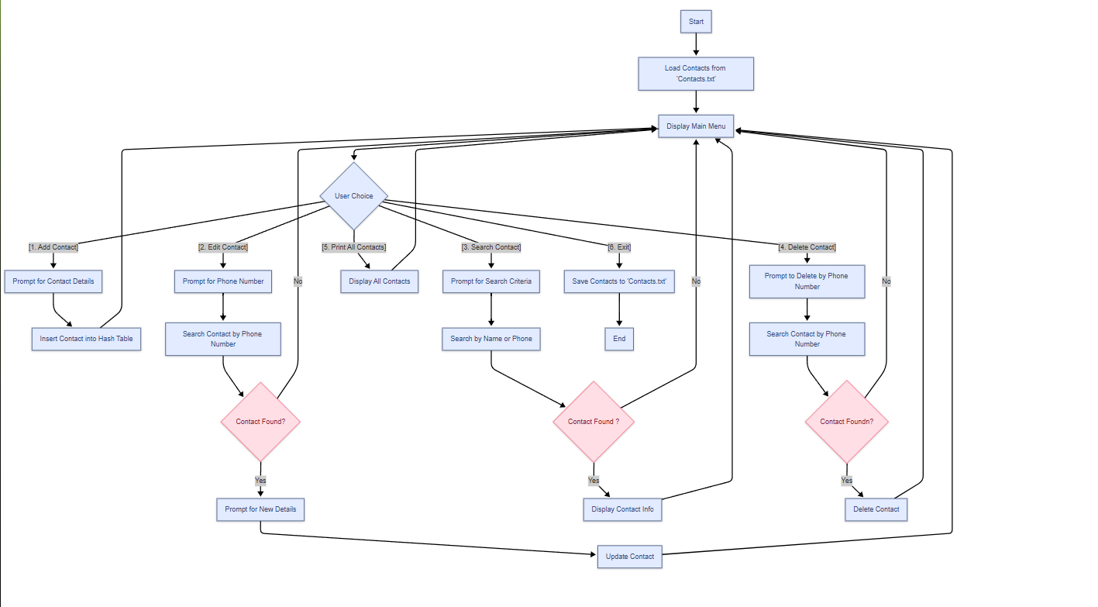
Flow chart
19

